Slide 1
How people resisted racism this Summer….

Slide 2
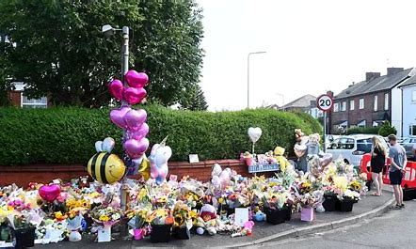
What happened
Tragic killing of 3 young people in Southport
Far right activists instantly reacted to news of the murders with lies and hate. They claimed the attacker was an “illegal immigrant” who had arrived on a small boat across the Channel. They said he was a Muslim known to MI6.
All wrong. All designed to make people hate Muslims.
In fact, the suspect had been born in Cardiff, Wales. The media reported he had parents who had come to Britain from Rwanda, and he is a Christian.

Slide 3
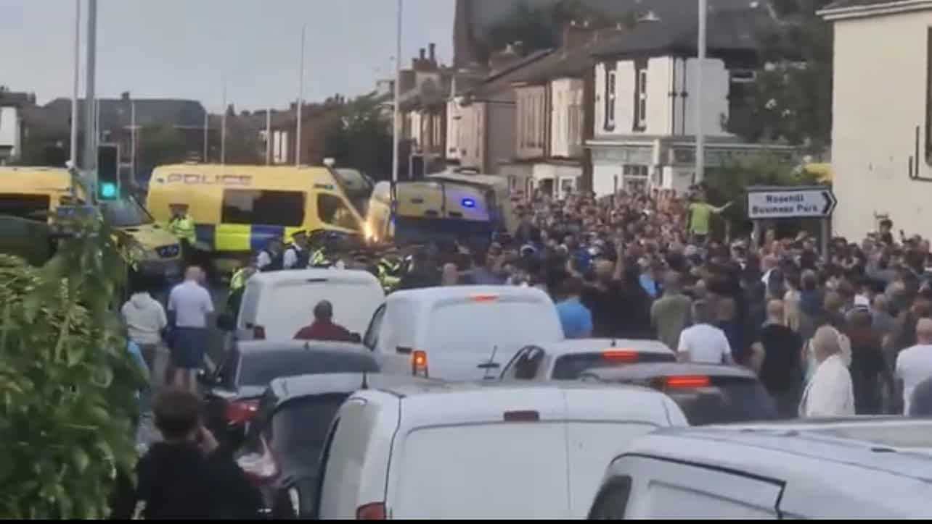
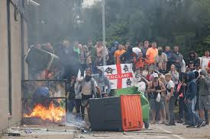
Riots
The most severe rioting took place over the weekend of 3–4 August, when the far right, racist protesters clashed with police and counter-protesters. They attacked homes and businesses owned by immigrants, attacked hostels housing asylum seekers, and tried to attack mosques.
They also attacked individual people of colour on the street.
Attempted attack on a mosque in Southport

Slide 4
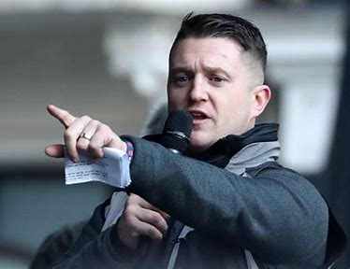
Who are the far right?
Tommy Robinson – Real name….Stephen Yaxley Lennon
He used to be in the British National Party – which was a racist party full of people who loved Hitler. So these people have been labelled Nazis, or the Italian version, Fascists…
He led the English Defence League – who were extremely Islamophobic
There are other organisations who are on the far right – such as Britain First, and Patriotic Alternative…
They have many targets for their hate.
People fleeing their countries due to war, famine, hardship, refugees or ‘migrants’
Muslims
People of colour
LGBT+ people, particularly Trans people
Although more hidden, they also hate Jews.

Slide 5
Who else uses divisive language?
Nigel Farage – REFORM UK – Has argued that migrants are the problem, and he is for the ordinary British person – in fact he’s a millionaire businessman, with a German wife.
Suella Braverman – the ex Conservative Home Secretary who made a speech based on a famous speech against racism by Martin Luther King..‘ I have a dream….’ She agrees with the ‘Great Replacement theory’
Rishi Sunak – ‘Stop the Boats’
Sadly…. Our new government is also focussing on stopping ‘illegal migrants’.

Slide 6
Some myths
Asylum seekers come here and don’t want to work…
Fact – the government will not allow them to work, and so are forced to live on very low benefits
People come here illegally…
Fact – there are now no legal, safe routes for people to enter the UK, if they don’t have their papers. It is very hard when you are fleeing to carry your papers, and many people don’t have these things.
3. People once here cost the government lots of money
Fact – Migrants who are mostly of working age or younger, contribute more in taxes than are taken in benefits.
4. Migrants are using up NHS resources.
Fact – no migrants, no NHS – in the last 5 years, there were 50,000 new nurses appointed. 45,000 of them came from other countries, such as the Philippines, India and Ghana.

Slide 7
Why does anyone listen to this stuff?
Cost of living crisis – food being so expensive
Heating homes being so expensive.
Lack of affordable housing
Difficulties getting doctors’ appointments…
People who are suffering want someone to blame….and unfortunately our governments have spent a lot of time pointing at migrants who come with nothing…who have not put up food prices, or fuel prices, or rents, or made the NHS struggle…

Slide 8
What was the response of ordinary people to the riots…
The Far Right said they would be gathering in towns and cities across the country on Wednesday August 7
People came out in their tens of thousands to form counter-protests and again and again, considerably outnumbered far-right protesters, and were followed by large anti-racist rallies across the country..
Across the country thousands of people came out of their homes to defend their areas against those who wanted to spread hatred.

Slide 9
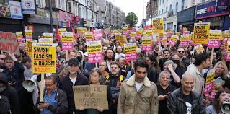
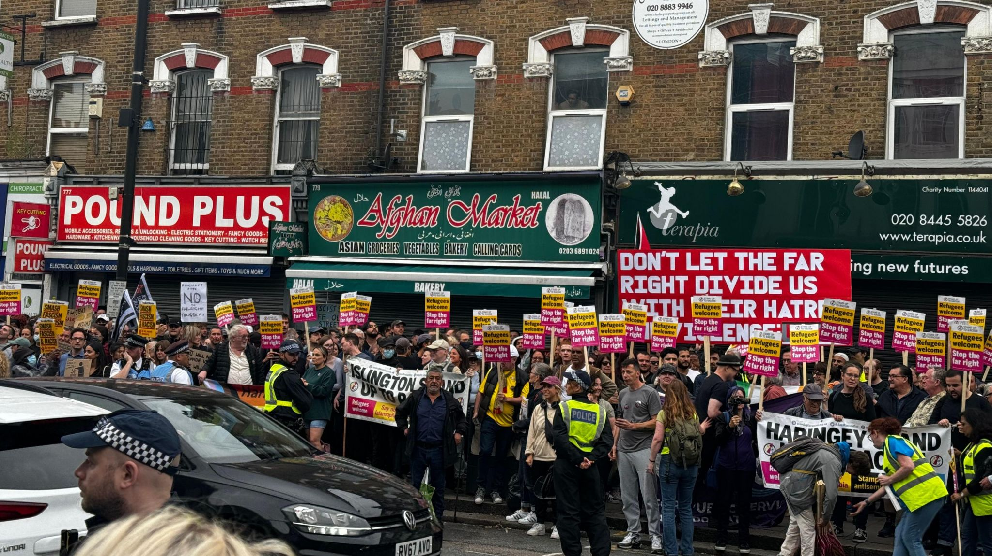
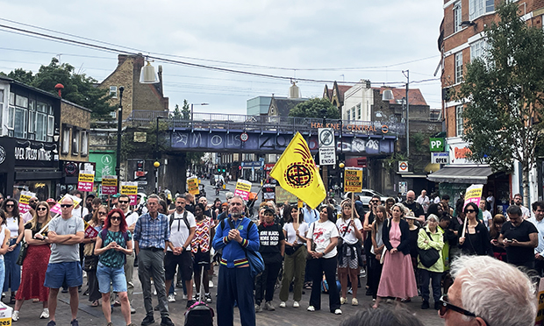
North Finchley 3000
Walthamstow 10,000
Hackney 500

Slide 10
Some of the many places anti-racists protested August 7
Bristol - 7,000
Liverpool - 1,500
Oxford – 500 - “More than 500 on the anti-racist side—150 close to the central mosque, 300 at the Asylum Welcome offices and 50 at the refugee hotel. Local Muslim taxi drivers are ferrying protesters up for free. “
Newcastle - 3,000
Sheffield - 1,500
Birmingham – 1,000
Brighton - 2,000
Nottingham - 500
Hastings - 500
Aldershot – 150

Slide 11
Bolton – 70, no far right turned up
Norwich - 100
Derby - 500
Hackney – 500 following a fascist threat to the local mosque. It was an extraordinary turnout at ten hours’ notice.
Lewisham – 500
Cheadle, Greater Manchester – 500
Bedford— 500
Brentford - west London, anti-fascists outnumbered the far right 100-to-one. The 400-strong crowd chanted, “There are many, many more of us than you” at the dejected-looking group.
North Harrow in west London – 400
Southend – 500 , to defend an immigration solicitor in Westcliff-on-Sea,

Slide 12
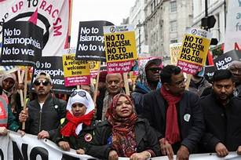
Why demonstrate?
If racists are going to demonstrate, this puts everyone in our community at risk. We need to defend our mosques, synagogues, etc. And we have to make sure our streets are safe for everyone in our community.
If many people show their determination to stop racism, it means the racists feel less confident to turn up and so their movement is weaker.
Hitler was the leader of the Nazis, who murdered 6 million Jewish people in the Holocaust and 6 million other people…. Roma, LGBT+, Africans, Trade Unionists, Jehovah’s witnesses and many more…
He said that if he had been stopped when his Nazi party was small, he would never have been able to come to power.
We need the people of hate, to remain small in number.

Slide 13
Not spontaneous
People didn’t just come out of their houses at the same time, to go to the same place by chance. People in many groups put the call out. Stand up to Racism, Trade unions, (including the education union), churches, mosques, synagogues…
What we do makes a difference.

Slide 14
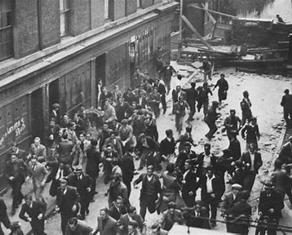
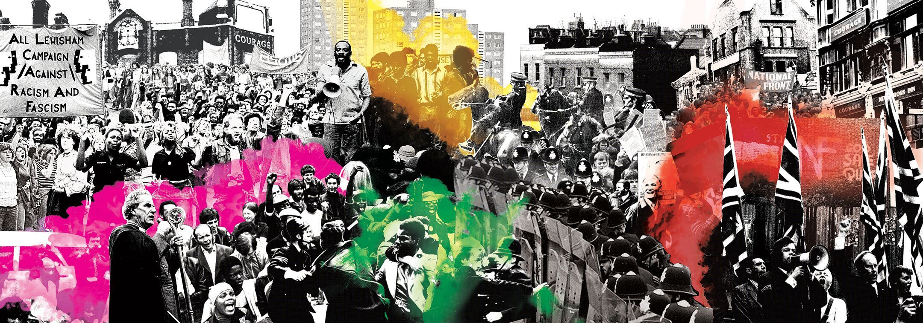
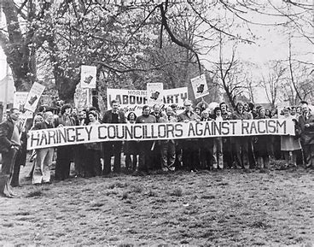
History of this resistance to racism
Cable Street 1936 – 300,000 Irish dockers, Jews, Socialists, Communists, Trade Unionists… and others gathered to stop the British Hitler – Oswald Mosley. The British Union of Fascists, never as strong again.
Lewisham 1977 – 4000 anti-racists met 500 of the National Front
and they were never as strong again
Wood Green 1977 –3000 anti racists met the National Front, and they were forced to leave.
Nick Griffin BNP election - 2010….Barking and Dagenham 2010 defeated as many anti-racists knocked on doors urging people not to vote for this man.

Slide 15
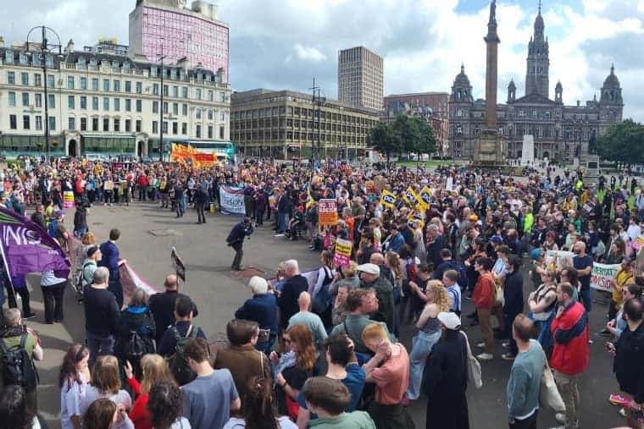
Be aware, these people who hate have not gone away….
In Glasgow – Scotland on Saturday September 7
500 racists gathered to be met by
5000 anti racists.
WHEN THEY MARCH
WE WILL MARCH – TO SHOW
WE WILL ALWAYS STAND UP TO RACISM

Slide 16
What does this mean for us….
There are many more anti-racist people than racists.
A lot of the information online about minority groups is not true. Check facts.
What we do makes a difference…
NEVER have words of hate in your mouth.
ALWAYS challenge language which picks on someone for their identity.
ALWAYS know you are not alone, and if you tell someone about discrimination, something will be done.
ALWAYS stand up for what is right. You feel better, and so do the people around you.

